Slide 1

Suburban Cook County Health Survey and Atlas
Alfreda Holloway-Beth, PhD, MS, Director of Epidemiology
C. Scott Smith, PhD, AICP, Epidemiologist
Notes:
Thanks for the opportunity to discuss CCDPH’s plans

Slide 2
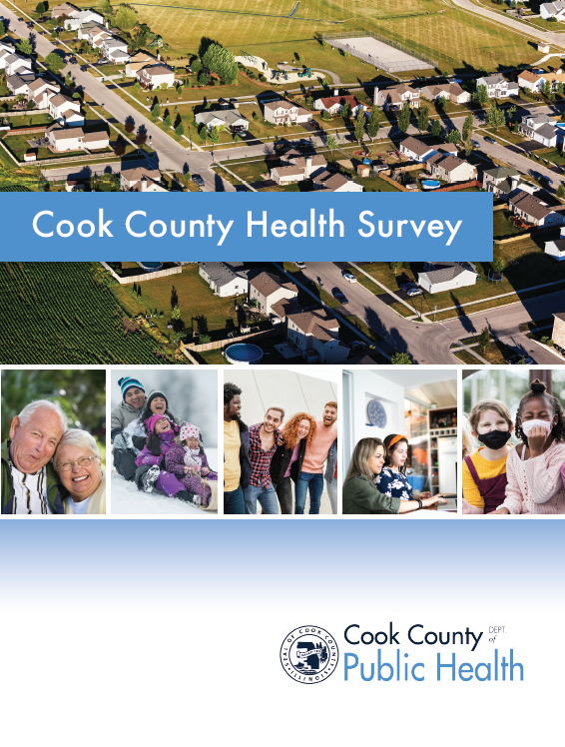
2022 COOK COUNTY HEALTH SURVEY
The Cook County Department of Public Health is conducting a health survey to monitor, evaluate and address health conditions across suburban Cook County.
SCOPE
The survey aims to collect data from 8,0000 adult (18 and older) suburban Cook County residents concerning their health-related risk behaviors, chronic health conditions, and access to health care.
PURPOSE
Findings from the survey will help inform health policy, program development, community education initiatives, and public awareness campaigns.
METHOD
Randomly selected residents will receive a postcard requesting their participation. The survey takes 25-30 minutes to complete, and respondents will receive a financial incentive for participating.
PRIVACY
Survey responses will be completely confidential. Contact information will be kept separate from survey data and summarized to further protect the anonymity of respondents.

Slide 3
Chronic disease
General health, diet & exercise
Childhood experiences
HEALTH SURVEY TOPIC AREAS
Cancer screening
Neighborhood
The survey collects data on a wide range of public health-related topics
Tobacco, cannabis, alcohol
Financial security
Mental health

Slide 4

HEALTH SURVEY ROADMAP
The survey is carried out through multiple steps.
DESIGN
DATA COLLECTION
Survey questions and related materials are designed in collaboration with UIC, CDPH and RTI International.
The final survey is completed by a stratified sample of at least 8,000 residents of suburban Cook County.
2
4
1
3
PILOT TEST
ANALYSIS AND SHARING
A pilot survey is sent out to 250 addresses as part of a systematic review of the questionnaire.
Data are quality controlled, analyzed summarized and uploaded to the Suburban Cook County Health Atlas.

Slide 5
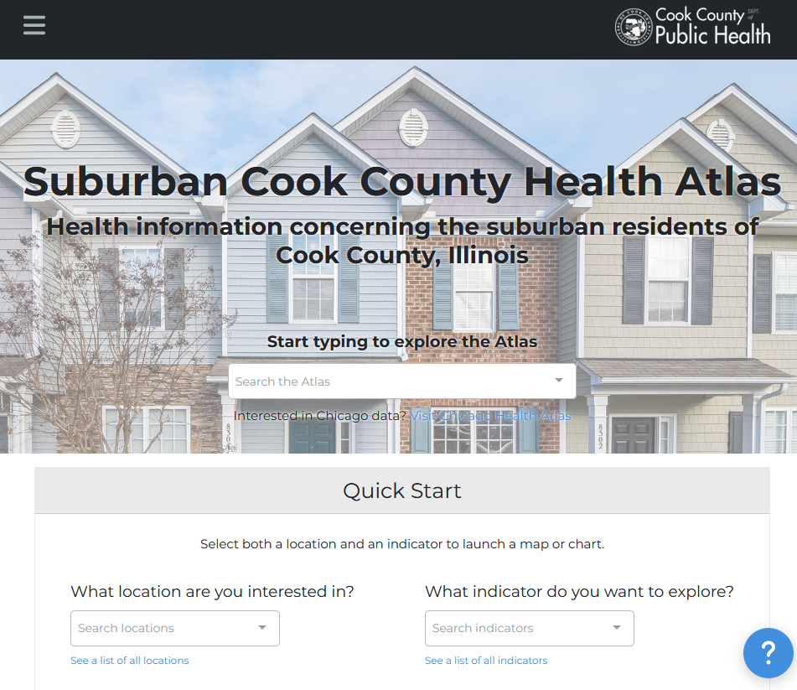
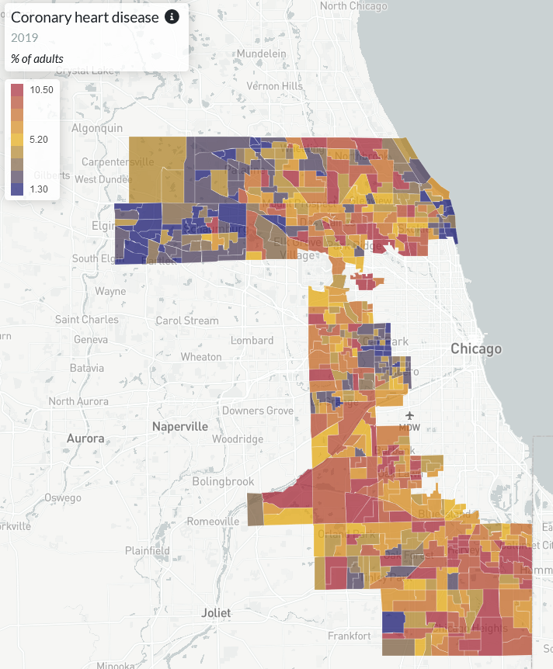


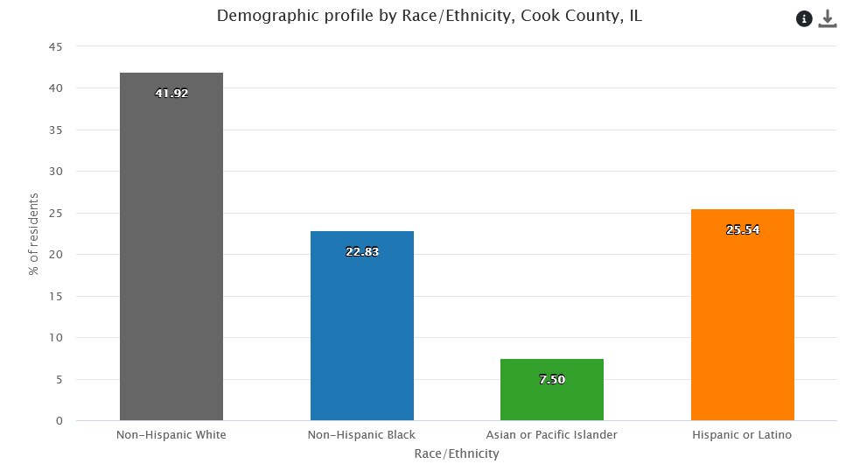
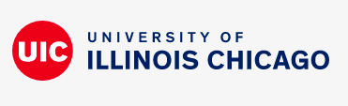
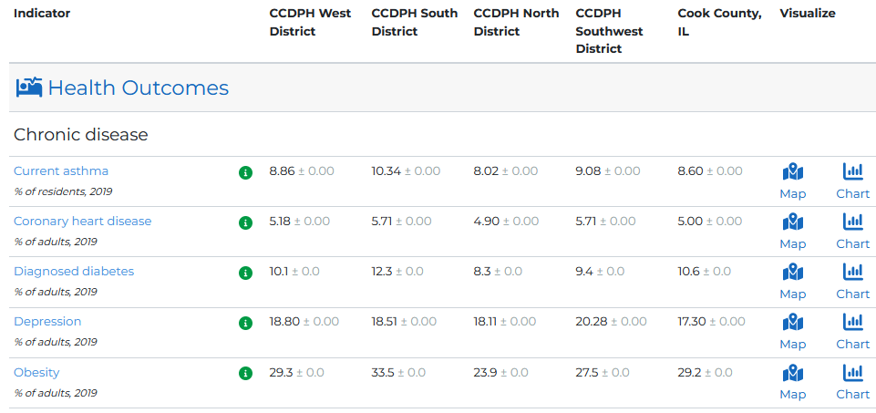
SUBURBAN COOK COUNTY HEALTH ATLAS
Using startup funds from CDC’s Health Equity Grant, CCDPH’s Epidemiology Unit is collaborating with UIC’s PHAME Center and Metopio to design and deploy an online atlas for exploring and sharing health information concerning the suburban residents of Cook County. The atlas allows stakeholders to examine, visualize and download health data using maps, charts and tables.
Notes:
The Cook County Department of Public Health’s Epidemiology Unit is leading an effort to design and deploy an online health atlas for suburban Cook County. We envision the atlas to be a platform for sharing a wealth of information to improve health awareness and decision-making. We are consulting with public health experts, working with other units within the department and reaching out to community members to identify what data to include.
In addition, the atlas contains several quality of life and risk indices related to public health that combine indicators across the six categories (e.g., social vulnerability index, index of concentration of extremes, neighborhood deprivation).

Slide 6


EVOLVING DATA SHARING ECOSYSTEM
[summary of data ].
SCC HEALTH ATLAS
STORY MAPS
Comprehensive, online health indicator data exploration and visualization tools designed for the broadest range of users
Immersive, topic-specific public health information presented using a combination of multimedia content including text and interactive maps
COOK COUNTY DATA PORTAL
CCDPH DATA REQUESTS
Comprehensive health indicator data made available in multiple delimited formats for expert users
Online forms for partner agencies, researchers, community groups and the general public to request custom CCDPH datasets.

Slide 7

HEALTH INDICATOR CATEGORIES
Indicators on the health atlas are organized into six primary categories.
HEALTH OUTCOMES
DEMOGRAPHICS
Consequences, complications and other outcomes that result from disease (e.g., injury, hospitalization, death).
Population characteristics including community size, composition and structure (e.g., population, age, gender, race/ethnicity, migration).
The platform integrates several types of data
HEALTH BEHAVIORS
SOCIOECONOMIC
Individual activities that influence health (e.g., alcohol, drug and tobacco use; diet, physical activity, sleep).
Social and economic factors that can affect health (e.g., income, employment, education, segregation).
HEALTH CARE
PHYSICAL ENVIRONMENT
Systems and services for administering care (e.g., health screenings; primary, prenatal and dental care; clinics, hospitals, FQHCs).
Characteristics of the places where individuals where individuals live, learn, work, and play (e.g., parks, housing, air quality, water quality and transportation)
Notes:
The Cook County Department of Public Health’s Epidemiology Unit is leading an effort to design and deploy an online health atlas for suburban Cook County. We envision the atlas to be a platform for sharing a wealth of information to improve health awareness and decision-making. We are consulting with public health experts, working with other units within the department and reaching out to community members to identify what data to include.
In addition, the atlas contains several quality of life and risk indices related to public health that combine indicators across the six categories (e.g., social vulnerability index, index of concentration of extremes, neighborhood deprivation).

Slide 8
HEALTH INDICATOR SUBCATEGORIES
The six primary categories are further broken down into several subcategories.
HEALTH OUTCOMES
PHYSICAL ENVIRONMENT
HEALTH BEHAVIORS
SOCIO-ECONOMIC
Chronic disease
Infectious disease
Injury and violence
Maternal & child
Community safety
Housing
Transportation
Pollution exposure
Environmental risk
HEALTH CARE
DEMO-GRAPHICS
Income
Education
Employment & occupation
Public assistance
Alcohol & drug use
Tobacco use
Diet & exercise
Sexual activity
Population age
Sex & gender
Race, & ethnicity
Household structure
Language
Migration status
Access to care
Quality of care
Facility utilization

Slide 9
health atlas FIRST YEAR DATA RELEASE TIMELINE
The atlas will be continually updated with the latest public health information for suburban Cook County. The rollout of the data over the first year will proceed in four phases. With each phase, the Epi Unit will reach out to other CCDPH units, the county and community-based contacts for data requests and feedback.
01
02
03
04
PHASE ONE (August 2022)
PHASE TWO
(September 2022)
PHASE THREE
(October 2022)
PHASE FOUR
(April 2023)
Select indicators from CCDPH’s latest Community Health Status Assessment; Social Vulnerability; Communicable disease prevalence; Opioid deaths
2013 to 2020 birth and death rates; environmental justice screening data
2018 to 2020 hospitalization inpatient and outpatient data
2022 Suburban Cook County Health Survey data

Slide 10
Thank You Questions? C. Scott Smith, PhD, AICP, Epidemiologist christopher.smith@cookcountyhealth.org
Notes:
CCDPH is one of 107 grant recipients.

